Slide 1
Lec-12 Algorithm Strategies
Md. Shamsujjoha

Slide 2
General Concepts
Algorithm strategy
Approach to solving a problem
May combine several approaches
Algorithm structure
Iterative ⇒ execute action in loop
Recursive ⇒ reapply action to subproblem(s)
Problem type
Satisfying ⇒ find any satisfactory solution
Optimization ⇒ find best solutions (vs. cost metric)

Slide 3
Some Algorithm Strategies
Divide and conquer algorithms
Dynamic programming algorithms
Greedy algorithms
Backtracking algorithms
Branch and bound algorithms
Heuristic algorithms
Approximation Algorithms
Evolutionary algorithm
Brute force algorithms
Randomized algorithms
And many more
Algorithms that use a similar problem-solving approach can be grouped together. This classification scheme is neither exhaustive nor disjoint. The purpose is not to be able to classify an algorithm as one type or another, but to highlight the various ways in which a problem can be attacked

Slide 4
1. Divide and Conquer Algorithm
Based on dividing problem into subproblems
Approach
Divide problem into smaller subproblems
Subproblems must be of same type
Subproblems do not need to overlap
Solve each subproblem recursively
Combine solutions to solve original problem
Usually contains two or more recursive calls
Notes:
2

Slide 5
Divide and Conquer – Examples
Binary Search
Quicksort
Partition array into two parts around pivot
Recursively quicksort each part of array
Concatenate solutions
Mergesort
Partition array into two parts
Recursively mergesort each half
Merge two sorted arrays into single sorted array
Counting Inversion
Notes:
3

Slide 6
Inversion Problem
Let a₁, . . . a_{n} be a permutation of 1 . . n
(a_{i}, a_{j}) is an inversion if i < j and a_{i} > a_{j}
Problem: given a permutation, count the number of inversions
Applications : Counting inversions can be use to measure how close ranked preferences are
People rank 20 movies, based on their rankings you cluster people who like that same type of movie

Slide 7
Counting Inversions: Divide-and-Conquer
Divide-and-conquer.
Divide: separate list into two pieces.
Conquer: recursively count inversions in each half.
Combine: count inversions where a_{i} and a_{j} are in different halves, and return sum of three quantities.
1
5
4
8
10
2
6
9
12
11
3
7
Divide: O(1).
1
5
4
8
10
2
6
9
12
11
3
7
Conquer: 2T(n / 2)
5 blue-blue inversions
8 green-green inversions
9 blue-green inversions
5-3, 4-3, 8-6, 8-3, 8-7, 10-6, 10-9, 10-3, 10-7
Combine: ???
Total = 5 + 8 + 9 = 22.

Slide 8
2. Dynamic Programming Algorithm
Based on remembering past results
Approach
Divide problem into smaller subproblems
Subproblems must be of same type
Subproblems must overlap
Solve each subproblem recursively
May simply look up solution
Combine solutions into to solve original problem
Store solution to problem
Generally applied to optimization problems

Slide 9
Fibonacci Algorithm
Fibonacci numbers
fibonacci(0) = 1
fibonacci(1) = 1
fibonacci(n) = fibonacci(n-1) + fibonacci(n-2)
Recursive algorithm to calculate fibonacci(n)
If n is 0 or 1, return 1
Else compute fibonacci(n-1) and fibonacci(n-2)
Return their sum
Simple algorithm ⇒ exponential time O(2^{n})

Slide 10
Dynamic Programming – Example
Dynamic programming version of fibonacci(n)
If n is 0 or 1, return 1
Else solve fibonacci(n-1) and fibonacci(n-2)
Look up value if previously computed
Else recursively compute
Find their sum and store
Return result
Dynamic programming algorithm ⇒ O(n) time
Since solving fibonacci(n-2) is just looking up value

Slide 11
Dynamic Programming - Example
0-1 Knapsack
Longest Common Subsequence
Longest Increasing Sequence
Sum of Subset
Warshall’s All pairs shortest path
Bellman Ford’s Single Source Shortest Path
Rock Climbing Problem
Matrix Chain Multiplication
TSP – Travelling Salesman Problem (Sahni)
OBST – Optimal Binary Search Tree (Cormen)
Optimal Polygon Triangulation (Sahni)
Sequence Alignment Problem

Slide 12
The Knapsack Problem
The 0-1 knapsack problem
A thief robbing a store finds n items: the i-th item is worth v_{i} dollars and weights w_{i} pounds (v_{i}, w_{i} integers)
The thief can only carry W pounds in his knapsack
Items must be taken entirely or left behind
Which items should the thief take to maximize the value of his load?
The fractional knapsack problem
Similar to above
The thief can take fractions of items

Slide 13
Longest Common Subsequence (LCS)
Given two sequences
X = ⟨x₁, x₂, …, x_{m}⟩
Y = ⟨y₁, y₂, …, y_{n}⟩
find a maximum length common subsequence (LCS) of X and Y
E.g.:
X = ⟨A, B, C, B, D, A, B⟩
Subsequences of X:
A subset of elements in the sequence taken in order
⟨A⟩, ⟨B⟩, … , ⟨A, B⟩ ⟨A, C⟩ , … ⟨A, B, C⟩, … , ⟨A, B, D⟩, ⟨B, C, D, B⟩, etc.
13

Slide 14
Example
X = ⟨A, B, C, B, D, A, B⟩ X = ⟨A, B, C, B, D, A, B⟩
Y = ⟨B, D, C, A, B, A⟩ Y = ⟨B, D, C, A, B, A⟩
⟨B, C, B, A⟩ and ⟨B, D, A, B⟩ are longest common subsequences of X and Y (length = 4)
⟨B, C, A⟩, however is not a LCS of X and Y
14

Slide 15
Longest increasing subsequence(LIS)
The longest increasing subsequence is to find a longest increasing subsequence of a given sequence of distinct integers a₁a₂…a_{n} .
e.g. 9 2 5 3 7 11 8 10 13 6
2 3 7
5 7 10 13
9 7 11
3 5 11 13
are increasing subsequences.
We want to find a longest one.
are not increasing subsequences.

Slide 16
Sum of Subset Problem
Problem:
Suppose you are given N positive integer numbers A[1…N] and it is required to produce another number K using a subset of A[1..N] numbers. How can it be done using Dynamic programming approach?
Example:
N = 6, A[1..N] = {2, 5, 8, 12, 6, 14}, K = 19
Result: 2 + 5 + 12 = 19

Slide 17
Coin Change Problem
Suppose you are given n types of coin - C₁, C₂, … , C_{n} coin, and another number K.
Is it possible to make K using above types of coin?
Number of each coin is infinite
Number of each coin is finite
Find minimum number of coin that is required to make K?
Number of each coin is infinite
Number of each coin is finite

Slide 18
Maximum-sum interval
Given a sequence of real numbers a₁a₂…a_{n} , find a consecutive subsequence with the maximum sum.
9 –3 1 7 –15 2 3 –4 2 –7 6 –2 8 4 -9
For each position, we can compute the maximum-sum interval starting at that position in O(n) time. Therefore, a naive algorithm runs in O(n²) time.

Slide 19
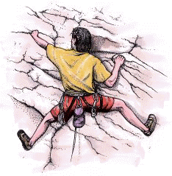
Rock Climbing Problem
A rock climber wants to get from the bottom of a rock to the top by the safest possible path.
At every step, he reaches for handholds above him; some holds are safer than other.
From every place, he can only reach a few nearest handholds.

Slide 20

Rock climbing (cont)
Suppose we have a wall instead of the rock.
4
At every step our climber can reach exactly three handholds: above, above and to the right and above and to the left.
5
3
2
There is a table of “danger ratings” provided. The “Danger” of a path is the sum of danger ratings of all handholds on the path.

Slide 21
Rock Climbing (cont)
We represent the wall as a table.
Every cell of the table contains the danger rating of the corresponding block.
2 | 8 | 9 | 5 | 8
4 | 4 | 6 | 2 | 3
5 | 7 | 5 | 6 | 1
3 | 2 | 5 | 4 | 8
2
5
4
2
5
1
2
4
The obvious greedy algorithm does not give an
optimal solution.
The rating of this path is 13.
However, we can solve this problem by a dynamic programming strategy in polynomial time.
The rating of an optimal path is 12.

Slide 22
Matrix-chain Multiplication
Suppose we have a sequence or chain A₁, A₂, …, A_{n} of n matrices to be multiplied
That is, we want to compute the product A₁A₂…A_{n}
There are many possible ways (parenthesizations) to compute the product
Example: consider the chain A₁, A₂, A₃, A₄ of 4 matrices
Let us compute the product A₁A₂A₃A₄
There are 5 possible ways:
(A₁(A₂(A₃A₄)))
(A₁((A₂A₃)A₄))
((A₁A₂)(A₃A₄))
((A₁(A₂A₃))A₄)
(((A₁A₂)A₃)A₄)

Slide 23
Matrix-chain Multiplication …contd
To compute the number of scalar multiplications necessary, we must know:
Algorithm to multiply two matrices
Matrix dimensions
Can you write the algorithm to multiply two matrices?
Input: Matrices A_{p×q} and B_{q×r} (with dimensions p×q and q×r)
Result: Matrix C_{p×r} resulting from the product A·B
MATRIX-MULTIPLY(A_{p×q} , B_{q×r})
1. for i ← 1 to p
2. for j ← 1 to r
3. C[i, j] ← 0
4. for k ← 1 to q
5. C[i, j] ← C[i, j] + A[i, k] · B[k, j]
6. return C
Scalar multiplication in line 5 dominates time to compute C
Number of scalar multiplications = pqr

Slide 24
Matrix-chain Multiplication …contd
Example: Consider three matrices A_{10×100}, B_{100×5}, and C_{5×50}
There are 2 ways to parenthesize
((AB)C) = D_{10×5} · C_{5×50}
AB ⇒ 10·100·5=5,000 scalar multiplications
DC ⇒ 10·5·50 =2,500 scalar multiplications
(A(BC)) = A_{10×100} · E_{100×50}
BC ⇒ 100·5·50=25,000 scalar multiplications
AE ⇒ 10·100·50 =50,000 scalar multiplications
Given a chain of matrices ⟨A₁, A₂, …, A_{n}⟩, where for i = 1, 2, …, n matrix A_{i} has dimensions p_{i-1}x p_{i}, fully parenthesize the product A₁ ⋅ A₂ ⋅⋅⋅ A_{n} in a way that minimizes the number of scalar multiplications.
A₁ ⋅ A₂ ⋅⋅⋅ A_{i} ⋅ A_{i+1} ⋅⋅⋅ A_{n}
p₀ x p₁ p₁ x p₂ p_{i-1} x p_{i} p_{i} x p_{i+1} p_{n-1} x p_{n}
Total: 7,500
Total: 75,000

Slide 25

Traveling Salesman Problem
Given a complete, weighted graph on n nodes, find the least weight Hamiltonian cycle, a cycle that visits every node once.
Though this problem is easy enough to explain, it is very difficult to solve.
Finding all the Hamiltonian cycles of a graph takes exponential time. Therefore, TSP is in the class NP.

Slide 26
Optimal Binary Search Tree (OBST)
Binary search trees for 3, 7, 9, 12
OBST is one special kind of advanced Binary Search Tree.
It focus on how to reduce the cost of the search on BST.
The Tree may not have the lowest height !
It needs 3 tables to record probabilities, cost, and root.

Slide 27
Optimal Binary Search Tree (OBST)
It has n keys (representation k₁,k₂,…,k_{n}) in sorted order (so that k₁<k₂<…<k_{n}), and we wish to build a binary search tree from these keys.
For each k_{i} ,we have a probability p_{i} that a search will be for k_{i}.
In contrast of, some searches may be for values not in k_{i}, and so we also have n+1 “dummy keys” d₀,d₁,…,d_{n} which is not in k_{i}.
In particular, d₀ represents all values less than k₁, and d_{n} represents all values greater than k_{n}, and for i=1,2,…,n-1, the dummy key d_{i} represents all values between k_{i} and k_{i+1}.
＊The dummy keys are leaves (external nodes), and the data keys mean internal nodes.

Slide 28
Optimal Binary Search Tree (OBST)
The case of search are two situations, one is success, and the other, without saying, is failure.
We can get the first statement :
(i=1~n) ∑ p_{i} + (i=0~n) ∑ q_{i} = 1
Success
Failure

Slide 29
Optimal Binary Search Tree (OBST)
Because we have probabilities of searches for each key and each dummy key, we can determine the expected cost of a search in a given binary search tree T.
Let us assume that the actual cost of a search is the number of nodes examined, i.e., the depth of the node found by the search in T plus 1.
Then the expected cost of a search in T is : (The second statement)
E[ search cost in T]
= (i=1~n) ∑ p_{i} ．(depth_{T}(k_{i})+1) + (i=0~n) ∑ q_{i} ．(depth_{T}(d_{i})+1)
=1 + (i=1~n) ∑ p_{i} ．depth_{T}(k_{i}) + (i=0~n) ∑ q_{i} ．depth_{T}(d_{i})
Where depth_{T} denotes a node’s depth in the tree T.

Slide 30
Optimal Binary Search Tree (OBST)
k2
k2
k1
k4
k1
k5
d0
d1
d0
d1
k4
d5
k3
k5
d2
d3
d4
d5
d4
k3
Figure (a)
i | 0 | 1 | 2 | 3 | 4 | 5
pi |  | 0.15 | 0.10 | 0.05 | 0.10 | 0.20
qi | 0.05 | 0.10 | 0.05 | 0.05 | 0.05 | 0.10
d2
d3
Figure (b)

Slide 31
Optimal Binary Search Tree (OBST)
By Figure (a), we can calculate the expected search cost node by node:
Node# | Depth | probability | cost
k1 | 1 | 0.15 | 0.30
k2 | 0 | 0.10 | 0.10
k3 | 2 | 0.05 | 0.15
k4 | 1 | 0.10 | 0.20
K5 | 2 | 0.20 | 0.60
d0 | 2 | 0.05 | 0.15
d1 | 3 | 0.10 | 0.30
d2 | 3 | 0.05 | 0.20
d3 | 3 | 0.05 | 0.20
d4 | 3 | 0.05 | 0.20
d5 | 3 | 0.10 | 0.40
Cost= Probability * (Depth+1)
And the total cost = (0.30 + 0.10 + 0.15 + 0.20 + 0.60 + 0.15 + 0.30 + 0.20 + 0.20 + 0.20 + 0.40) = 2.80
So Figure (a) costs 2.80
Similarly Figure (b) will costs 2.75 and that tree is really optimal than that of Figure (a).
Problem : Find the binary search tree with optimal (Least) cost.

Slide 32
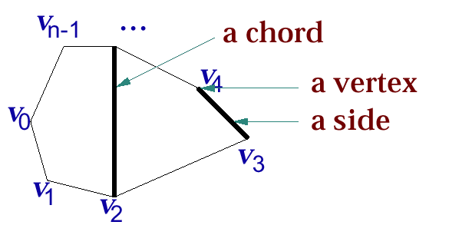
Optimal Polygon Triangulation
A polygon is a closed collection of lines (called sides) in the plane. A point joining two sides is a vertex. The line segment between two nonadjacent nodes is a chord. A polygon is convex if any chord is either on the boundary or in the interior of the polygon.
A polygon is represented by listing its vertices in counterclockwise
order <v₀, v₁, … , v_{n-1}> represents the right polygon.

Slide 33
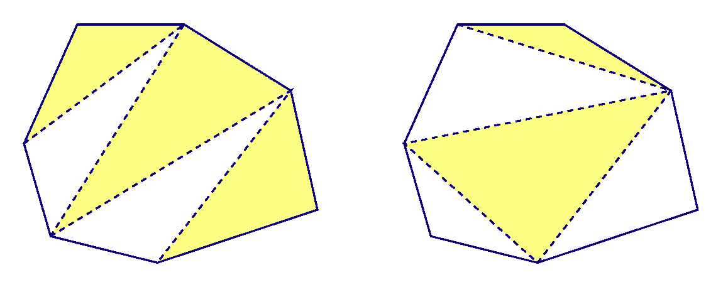
Optimal Polygon Triangulation
A triangulation of a polygon is a set T of chords of the polygon that divides the polygon into disjoint triangles. Every triangulation of an n-vertex polygon has n – 3 chords and divides the polygon into n – 2 triangles.

Slide 34
Optimal Polygon Triangulation
The weight of a triangle v_{i}v_{j}v_{k}, denoted by w(v_{i}v_{j}v_{k}), is |v_{i}v_{j}| + |v_{j}v_{k}|+ |v_{k}v_{i}|, where |v_{i}v_{j}| is the Euclidean distance between v_{i} and v_{j}.
The optimal (polygon) triangulation problem is the problem of finding a triangulation of a convex polygon that minimizes the sum of the weights of the triangles in the triangulation.
Given a triangulation with chords ℓ₁, …, ℓ_{n-3}, the weight-sum can be rewritten as:
Note that v_{n} = v₀.

Slide 35
Sequence Alignment Problem
Problem:
Input: Two (or more) sequences S₁, S₂, …, S_{n}, and a scoring function f.
Output: The alignment of S₁, S₂, …, S_{n} which has the optimal score.
S₁ = TAGTCACG
S₂ = AGACTGTC
----TAGTCACG
AGACT-GTC---
We can set different gap penalties as parameters for different purposes.
Which one is better?
Purpose:
To determine how close two species are
To perform data compression
To determine the common area of some sequences
To construct evolutionary trees
TAGTCAC-G--
-AG--ACTGTC

Slide 36
Greedy Algorithm
Based on trying best current (local) choice
Approach
At each step of algorithm choose best local solution
Avoid backtracking, exponential time O(2^{n})
Hope local optimum lead to global optimum
Notes:
2

Slide 37
Greedy Algorithm – Example
Kruskal’s Minimal Spanning Tree Algorithm
sort edges by weight (from least to most)
tree = ∅
for each edge (X,Y) in order
if it does not create a cycle
add (X,Y) to tree
stop when tree has N–1 edges
Picks best local solution at each step

Slide 38
Greedy Algorithm - Example
Dijkstra’s Single Source Shortest Path
Minimum Spanning Tree – Prim & Kruskal
Fractional Knapsack Problem
Huffman Coding
Coin Changing Problem (DP ???)
Prefix Codes: Encoding with Binary Character Codes
The Activity Selection Problem

Slide 39
Prefix Codes
A character ←→ a group of bits
Letters (A, B, ..),
numbers (1, 2,..),
special symbols (#, $, ..)
1000001
Prefix codes:
Codes for which no codeword is also a prefix of some other codeword
Better name would be “prefix-free codes”
We can achieve optimal data compression using prefix codes
We will restrict our attention to prefix codes

Slide 40
Binary Character Codes
Encoding: Concatenate the codewords representing each character in the file
E.g.: a = 0, b = 101, c = 100, d = 111, e = 1101, f = 1100
abc = 0 ⋅ 101 ⋅ 100 = 0101100
Decoding: Identify characters of file form the received codewords
Prefix codes simplify decoding
No codeword is a prefix of another ⇒ the codeword that begins an encoded file is unambiguous
Approach
Identify the initial codeword, Translate it back to the original character, Repeat the process on the remainder of the file
E.g.: a = 0, b = 101, c = 100, d = 111, e = 1101, f = 1100
001011101 =
0
⋅ 0
⋅ 101
⋅ 1101
= aabe

Slide 41
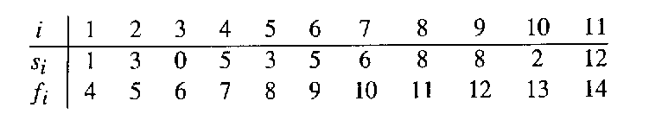
The Activity Selection Problem
Input: A set of activities S = {a₁,…, a_{n}}
Each activity has start time and a finish time
a_{i}=(s_{i}, f_{i})
Two activities are compatible if and only if their interval does not overlap
Output: a maximum-size subset of mutually compatible activities
Here are a set of start and finish times
What is the maximum number of activities that can be completed?
{a₃, a₉, a₁₁} can be completed
But so can {a₁, a₄, a_{8’} a₁₁} which is a larger set
But it is not unique, consider {a₂, a₄, a_{9’} a₁₁}

Slide 42
The Activity Selection Problem
Input: list of time-intervals L
Output: a non-overlapping subset S of the intervals
Objective: maximize |S|
3,7
2,4
5,8
6,9
1,11
10,12
0,3

Slide 43
The Activity Selection Problem
Input: list of time-intervals L
Output: a non-overlapping subset S of the intervals
Objective: maximize |S|
3,7
2,4
5,8
6,9
1,11
10,12
0,3
Answer = 3

Slide 44
Backtracking Algorithm
Based on depth-first recursive search
Approach
Tests whether solution has been found
If found solution, return it
Else for each choice that can be made
Make that choice
Recur
If recursion returns a solution, return it
If no choices remain, return failure

Slide 45
Backtracking - Example
Maze path finding
Graph Coloring
8 Queen Problem
Sum of Subset (DP ???)
Hamiltonian Cycle
Travelling Salesman Problem (TSP) (DP ???)
Permutation & Combination Generation Problem

Slide 46
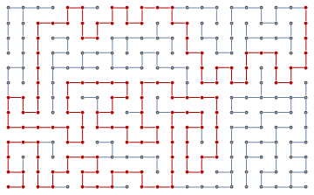
Maze path finding
Find path through maze
Start at beginning of maze
If at exit, return true
Else for each step from current location
Recursively find path
Return with first successful step
Return false if all steps fail

Slide 47
Graph Coloring
Color a map with no more than four colors
If all countries have been colored return success
Else for each color c of four colors and country n
If country n is not adjacent to a country that has been colored c
Color country n with color c
Recursively color country n+1
If successful, return success
Return failure

Slide 48
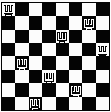
Eight Queens Problem
Find an arrangement of 8 queens on a single chess board such that no two queens are attacking one another.
In chess, queens can move all the way down any row, column or diagonal (so long as no pieces are in the way).
Due to the first two restrictions, it's clear that each row and column of the board will have exactly one queen.

Slide 49
Hamiltonian Cycle Problem
A Hamiltonian cycle in a graph is a cycle that visits each vertex exactly once
Problem Statement
Input: A directed graph G = (V,E)
Output: Whether the graph contains a Hamiltonian cycle or not

Slide 50
Branch and Bound Algorithm
A counter-part of the backtracking search algorithm which, in the absence of a cost criteria, the algorithm traverses a spanning tree of the solution space using the breadth-first approach. That is, a queue is used, and the nodes are processed in first-in-first-out order.
i.e, Based on limiting search using current solution
Approach
Track best current solution found
Eliminate partial solutions that can not improve upon best current solution
Reduces amount of backtracking
Not guaranteed to avoid exponential time O(2^{n})
Notes:
2

Slide 51
Branch and Bound – Example
Branch and bound algorithm for TSP
Find possible paths using recursive backtracking
Track cost of best current solution found
Stop searching path if cost > best current solution
Return lowest cost path
If good solution found early, can reduce search
May still require exponential time O(2^{n})

Slide 52
Heuristic Algorithm
The term heuristic is used for algorithms which find solutions among all possible ones ,but they do not guarantee that the best will be found,therefore they may be considered as approximately and not accurate algorithms.
Based on trying to guide search for solution
Heuristic ⇒ “rule of thumb”
Approach
Generate and evaluate possible solutions
Using “rule of thumb”
Stop if satisfactory solution is found
Can reduce complexity
Not guaranteed to yield best solution

Slide 53
Heuristic Algorithm – Example
Heuristic algorithm for TSP
Find possible paths using recursive backtracking
Search 2 lowest cost edges at each node first
Calculate cost of each path
Return lowest cost path from first 100 solutions
Not guaranteed to find best solution
Heuristics used frequently in real applications

Slide 54
Approximation Algorithms
Approximation Algorithm
produces “near-optimal” solution
Algorithm has approximation ratio ρ(n) if:
Approximation Scheme
(1+ε)-approximation algorithm for fixed ε
ε > 0 is an input
Polynomial-Time Approximation Scheme
time is polynomial in n
C = cost of algorithm’s solution
C* = cost of optimal solution
n = number of inputs = size of instance

Slide 55
Approximation Algorithms
Approximation Algorithm
produces “near-optimal” solution
Algorithm has approximation ratio ρ(n) if:
Approximation Scheme
(1+ε)-approximation algorithm for fixed ε
ε > 0 is an input
Polynomial-Time Approximation Scheme
time is polynomial in n
C = cost of algorithm’s solution
C* = cost of optimal solution
n = number of inputs = size of instance

Slide 56
Evolutionary Algorithms (EAs)
A type of Guided Random Search
Used for optimization problems
Based on the idea of biological evolution
The power of the evolutionary algorithms is limited by the lack of a clear genotype-phenotype distinction.
It has its own parameters.
EAs are known as global optimization methods which work well on ‘noisy’ functions which have many local optima

Slide 57
Brute force algorithm
A brute force algorithm simply tries all possibilities until a satisfactory solution is found
Such an algorithm can be:
Optimizing: Find the best solution. This may require finding all solutions, or if a value for the best solution is known, it may stop when any best solution is found
Example: Finding the best path for a travelling salesman
Satisficing: Stop as soon as a solution is found that is good enough
Example: Finding a travelling salesman path that is within 10% of optimal

Slide 58
Randomized algorithms
A randomized algorithm uses a random number at least once during the computation to make a decision
Example: In Quicksort, using a random number to choose a pivot
Example: Trying to factor a large prime by choosing random numbers as possible divisors

Slide 59
Next Class
A Long Lecture
Quiz 2
A DC solution to the sorting problems
Merge Sort, Quick Sort
Counting Inversions.
Greedy Solutions to the Problems :
The Coin Changing Problem
The Knapsack Problem
Huffman Codes
Prefix Codes
Decoding with Binary Character Codes

